Slide 1
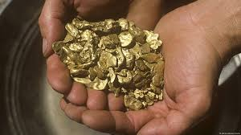
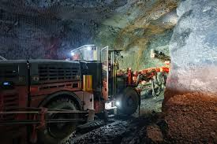
Gold Trade in Ghana and South Africa
Project group members
Ana Fernandez Vega
Asım Emre ACI
Burak Gülerçe
Prince Sangitaben Patel
Varun Rameshkumar Chothani
Vamshi Abhishake Tekulapally
Rupali Milind Patil
Mahdi Rajabi
Arun Kallingal Mohankumar
Oscar Antonio Garcia Arzu
Mohammed Feroz Shaik

Slide 2
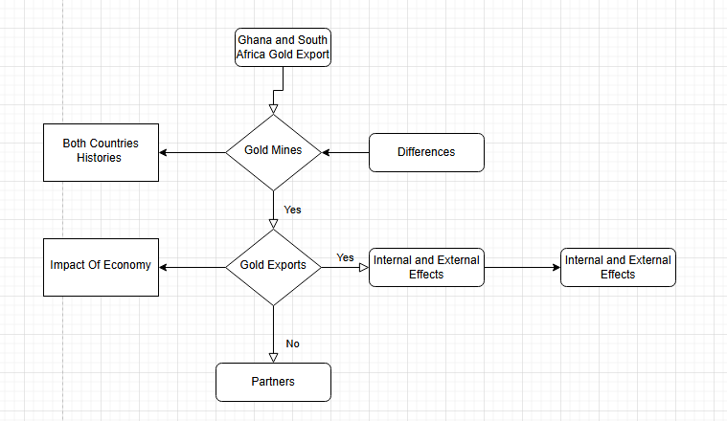
Project Details

Slide 3
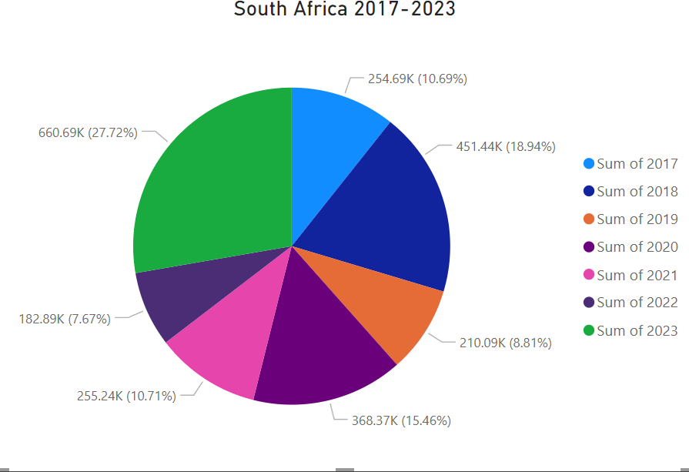
Ghana’s and South Africa’s Trade through the Years with Evolution
In this Graph shown 2017-2023 Gold Trade Evolutions
How did it evolve
Colonism effect
Globalization
Demands and Goverments Policies

Slide 4
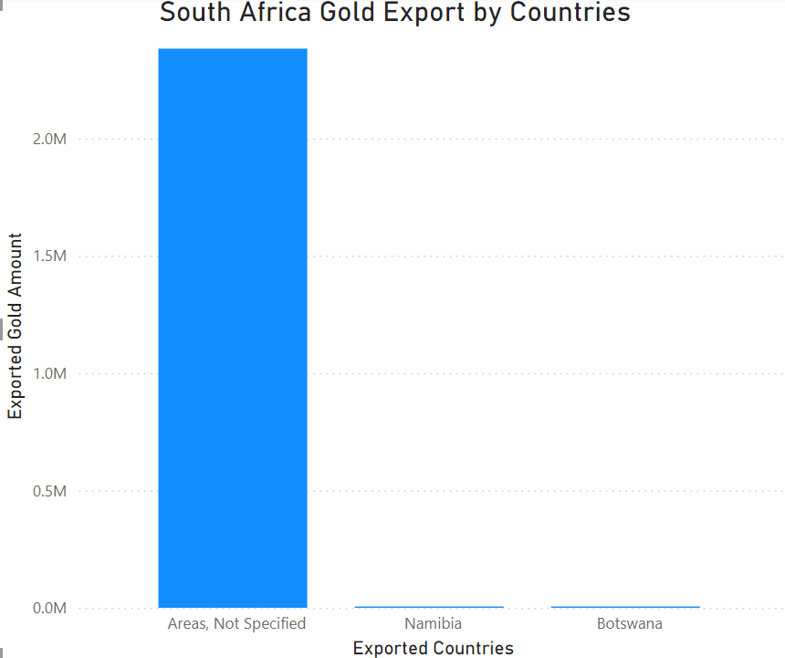
South Africa's 2020 Trade list
Export trade route for South Africa:

Slide 5
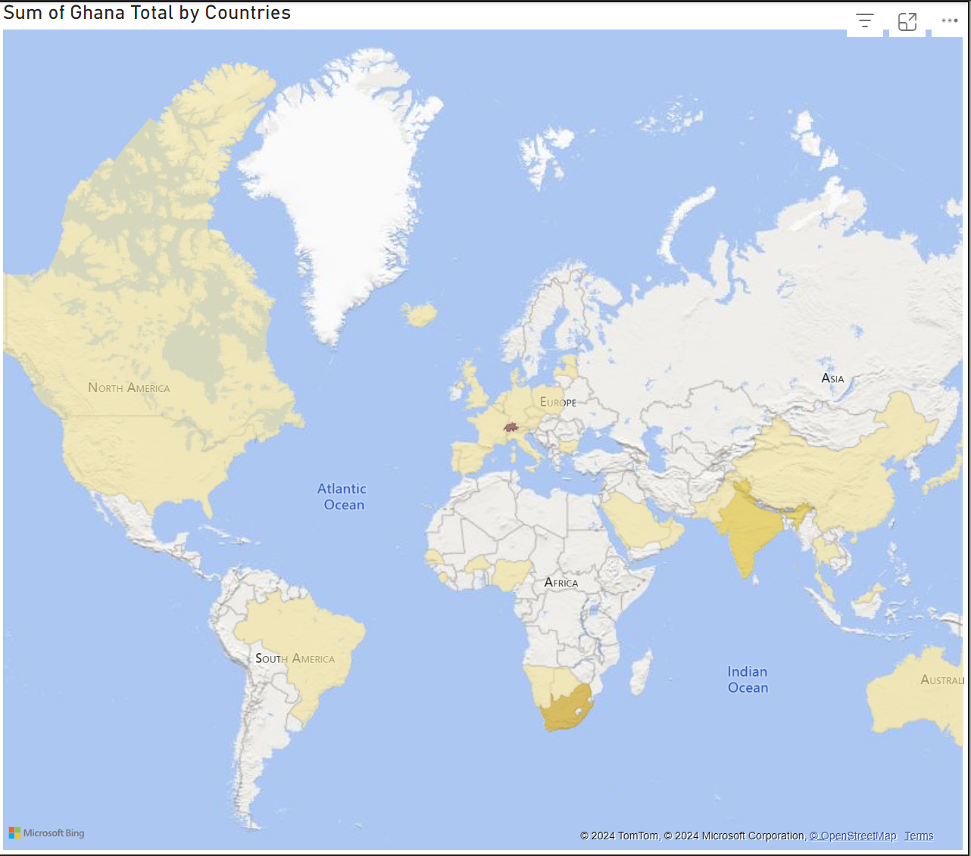
2020 Ghana's Trade Table
*This map shows the trade partners for Ghana at 2020.
Eu countries
Usa
Canada
Brazil
Arabia
South Africa
China
India
Australia

Slide 6
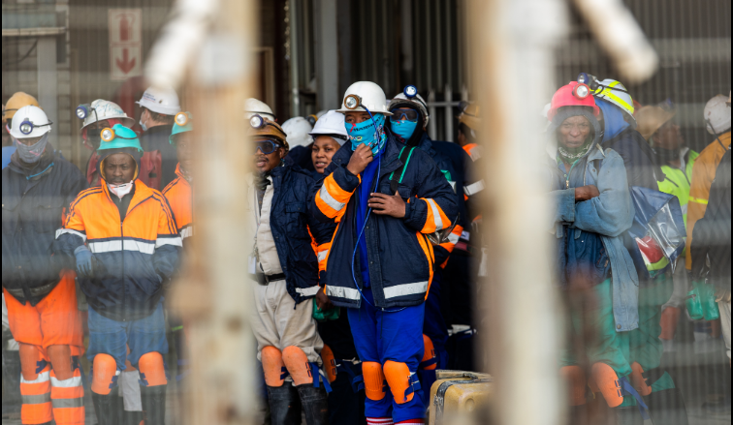
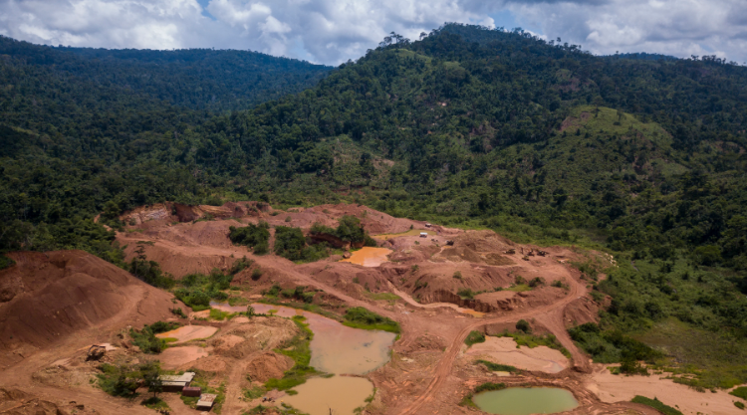
Impact Of Covid-19 Gold Mines
Lockdown affected the whole world
Curfew at mines
People cannot work
Decrease of Production
Decrease of Export
Impact on Economy

Slide 7
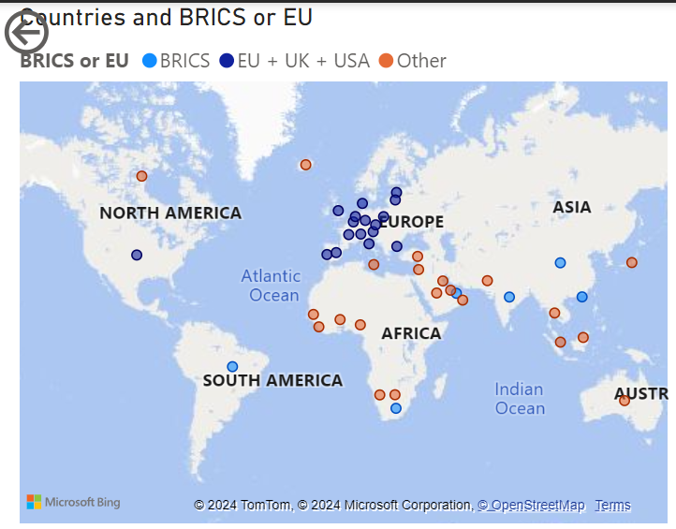
Trade Partners For South Africa
USA
Africa
India
BRICS and Western Countries

Slide 8
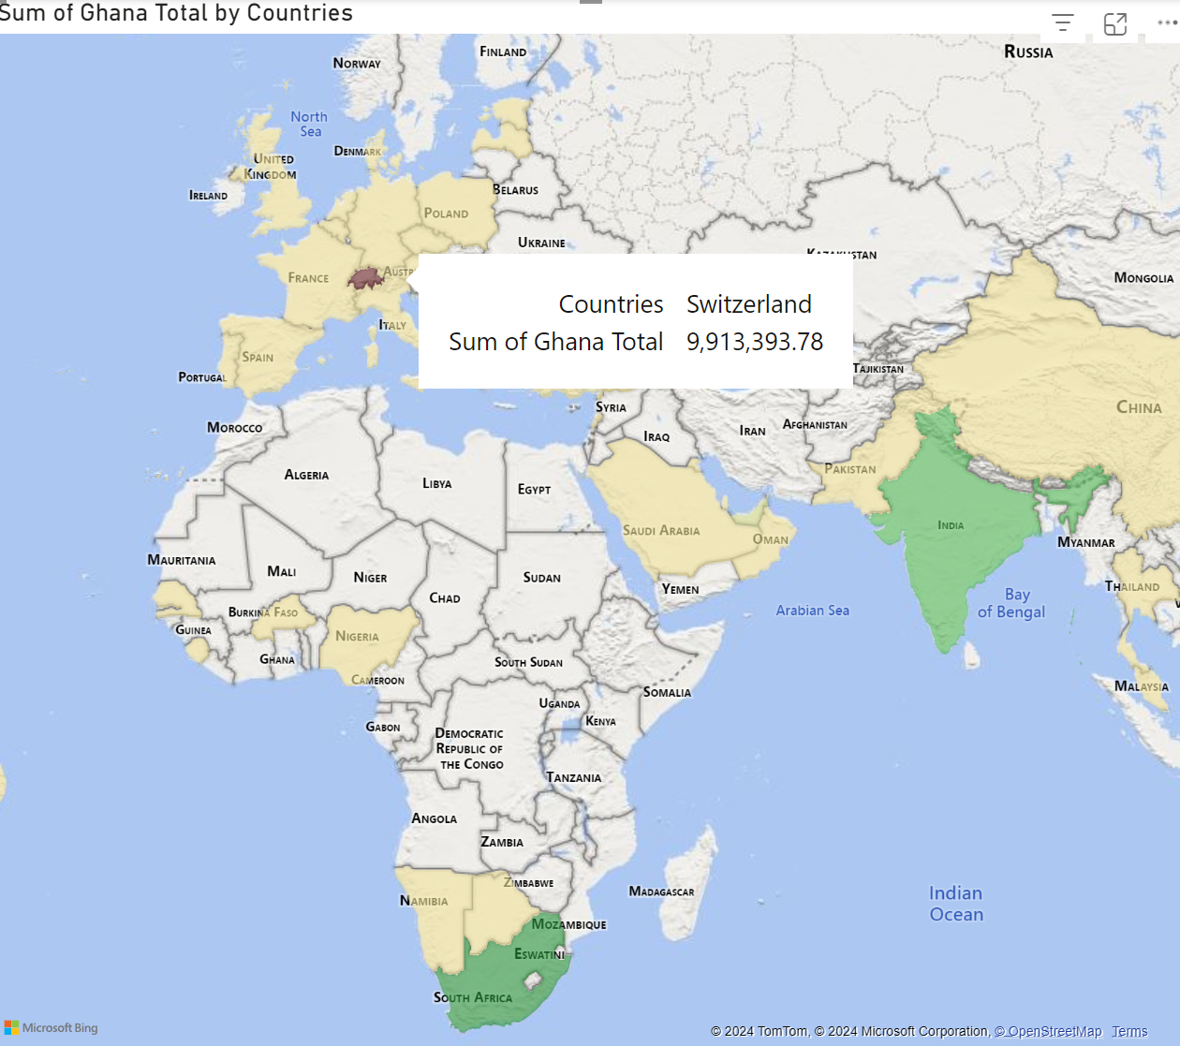
Trade Partners For Ghana
Switzerland is the biggest partner
Eu countries
India
China
South Africa

Slide 9
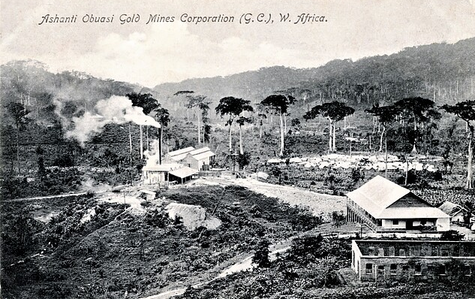
History Of Ghana first mine fields
Obuasi and Tarkwa
Historical Techniques in mine fields
Golden Coast

Slide 10
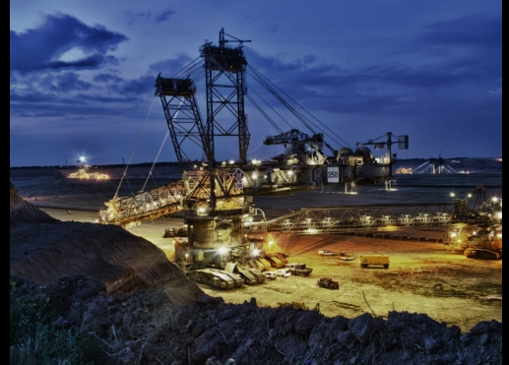
Ghana's Gold Mines Current Technology
What are the new technologies
What is differences between past and present
Foreign investment?
Does it effect export?

Slide 11
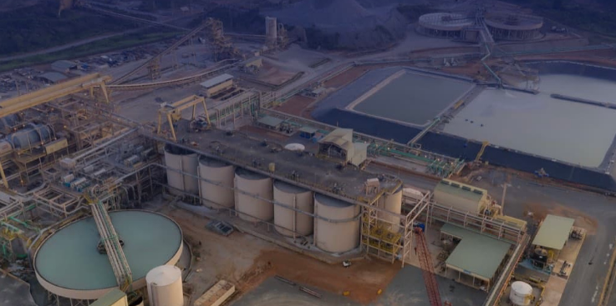
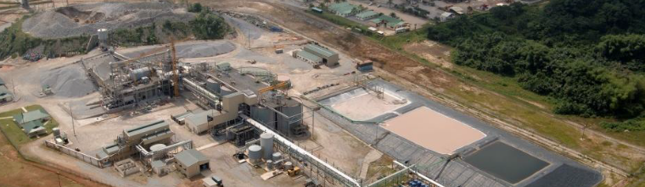
TARKWA And AKYEM Gold Mines
Akyem Gold Mine on the left
Employment ?
Tarkwa Gold Mine on the right
Impact of the national export

Slide 12
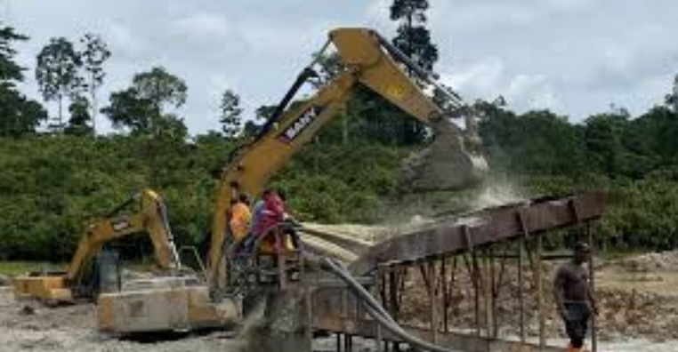
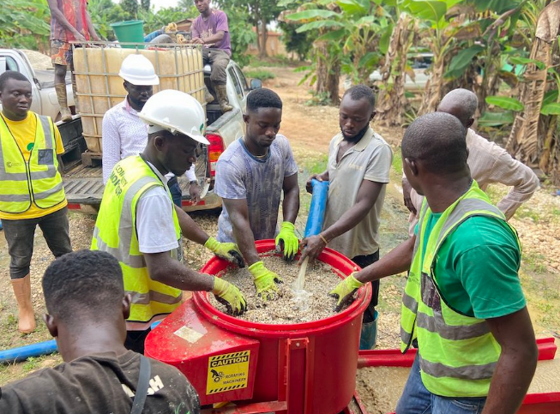
Current Gold Mines Equipment And Practices In Ghana
Modern Machinery
Practices
Metin eklemek için tıklayın
Are traditions use at the moment?
Technology for enviromental effect

Slide 13
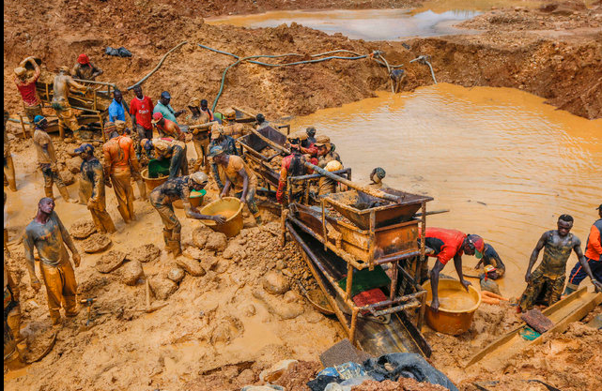
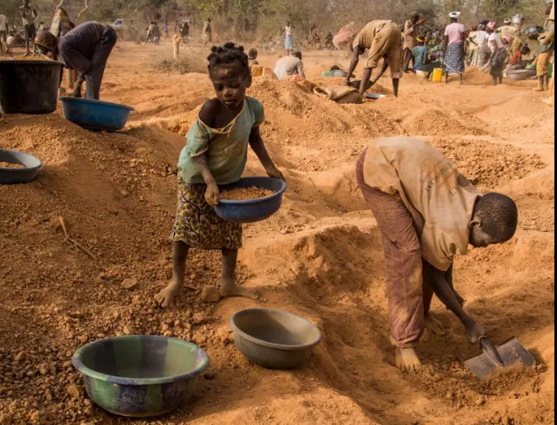
Challanges In Ghana's Mines
Human rights' abusive
High competition increase illegal mines
Potential harm for environment
Child labor
Harsh environment
Water resources?

Slide 14
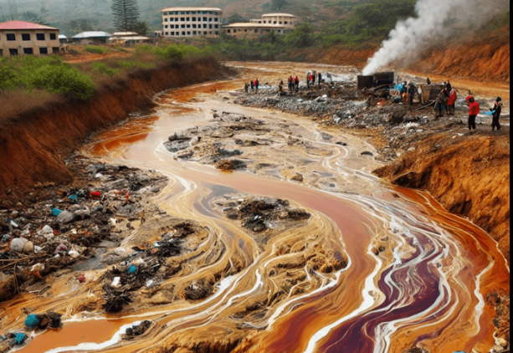
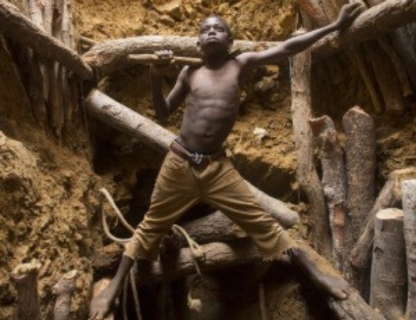
Ghana'sTrade Union and Environmental Challenges In Gold Industry
Due to cynanide and mercury water pollution
Illegal mines trigger deforestation
Childs take risky actions
Risk of Water diminish
Long-term effect of agriculture and health

Slide 15
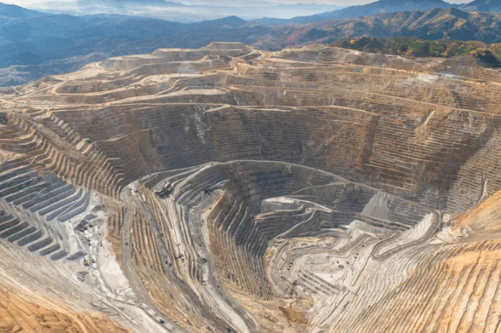
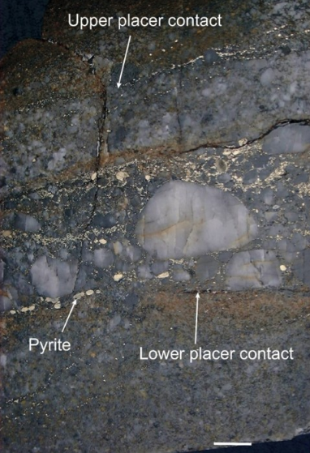
Historical Mine Fields In South Africa
One of the world's richest gold mine
Before 1994 South Africa top gold producer
Colonism effect?
How does it help South Africa's domination

Slide 16
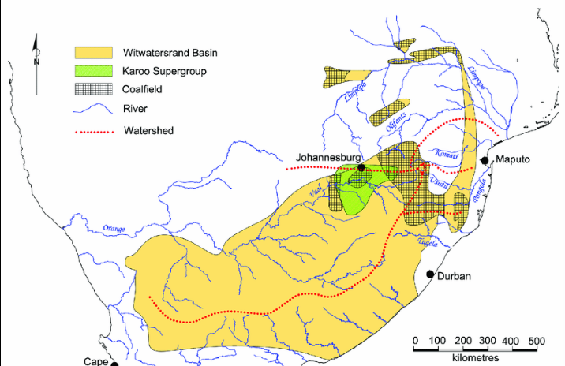
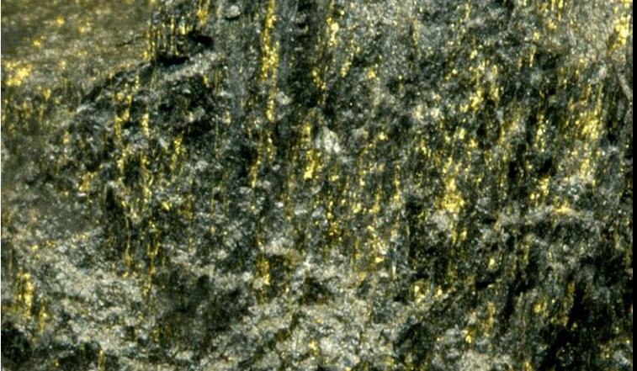
Analyses Witwaters Basin Gold Mine
On the left raw gold mine from Witwaters
The mine locates 70-80 kilometers west of Johannesburg
Produces more than 100 million ounces in last 50 year
What are the contribution for the country
Future problems?

Slide 17
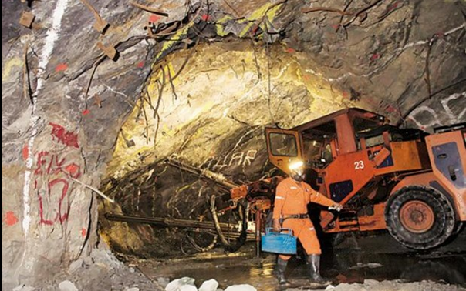
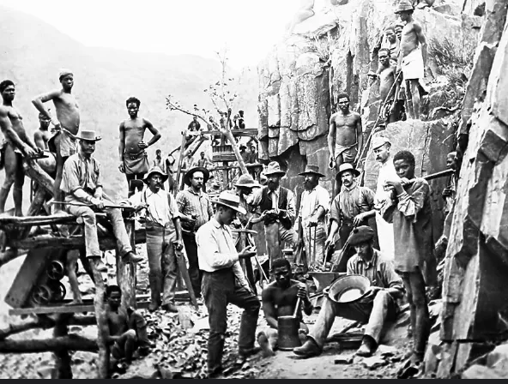
Mining Activities Current South Africa
On the picture on the right: people working with muscle power and old equipments

Slide 18
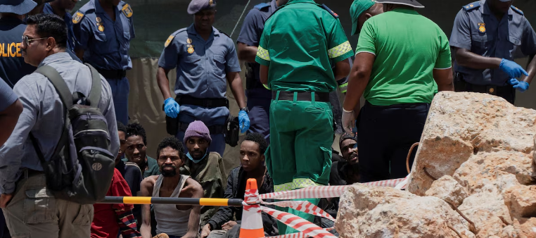
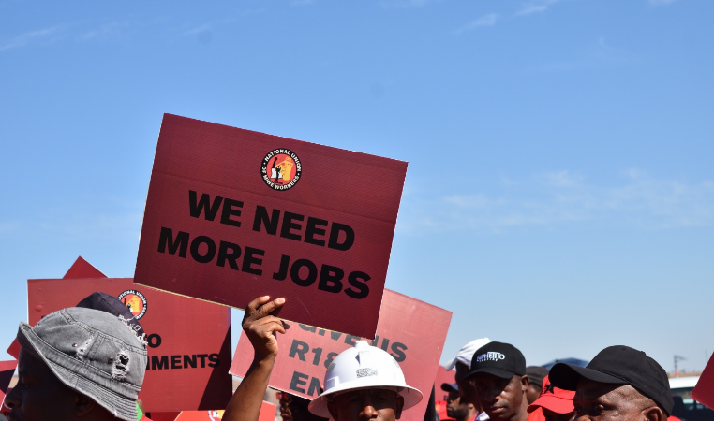
Problems Employees Facing In South Africa Mines
Due to high competition illegal mines
Death because of illegal mines safety
Productivity?
Lack of Job due to illegal mines
Costs?

Slide 19
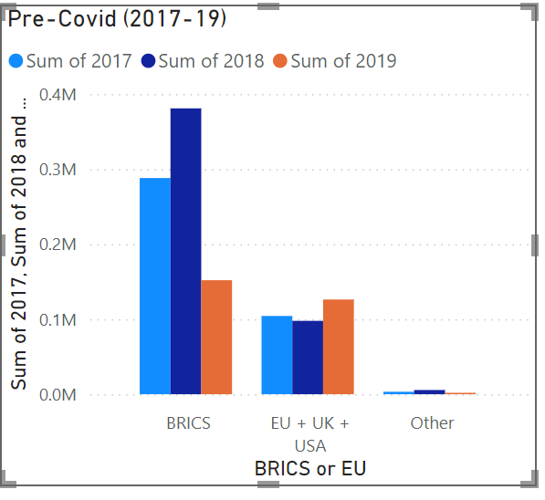
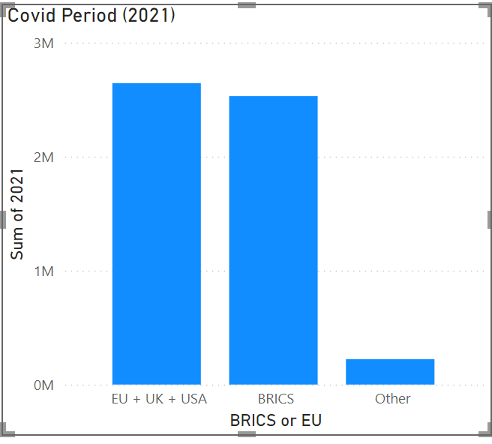
Covid-19 Effects on South Africa Gold Mine
Pre-Covid Era on the left
What are the production effects?
Lockdowns affect the Economy
Loses?
Covid-19 Period On the right
Strategies
Long-term plans
Outcome problems?

Slide 20
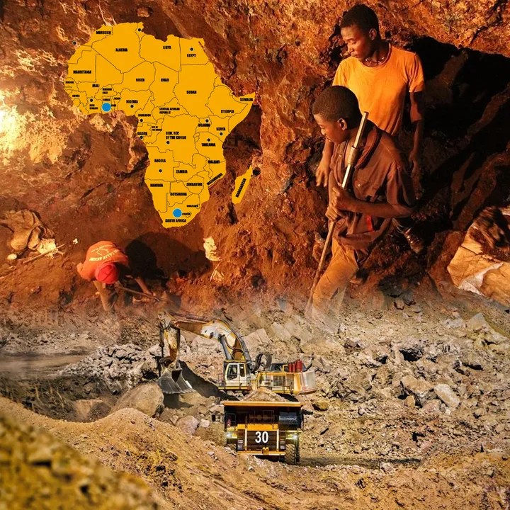
Chanllenges For Both Countries
Cost
It implications
Culture
Expertise
Labor Issues
Economic Pressures
Regulations

Slide 21
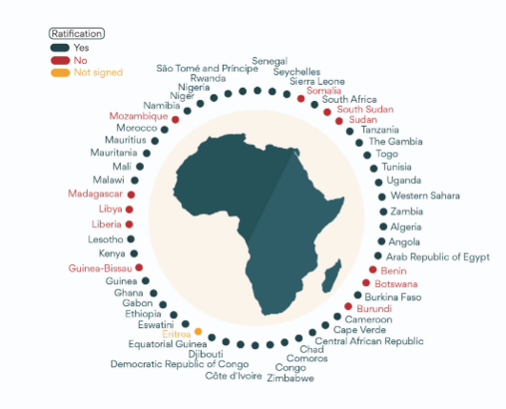
Member And Sustainability AfCFTA
Left figures is that which countries member of it
Contribution for region
Gold trades effects
Regional integrations increase it?

Slide 22

Strategies For Both Country
Product differentiation
Manage environmental problems
Emphasises AfCFTA opportunities
Enhancing Co-Operations for gold production
New Markets
New alliances Co-Operations

Slide 23

Proposed Solutions For Country Base
For South Africa's perspective:
Upgrade mining industry base
Solve labor problems
Clear policy related with foreign investment
Make plans and structures
For Ghana's perspective:
Tighten current mining policies
Cost-conservative measures
Ecological Principles
Distribute acroos more Region

Slide 24


